Slide 1
Dynatrace POC
Planning Document

Slide 2
Your Dynatrace Account Team
Name
Account Manager
Date
Name
Sales Engineer

Slide 3
Dynatrace POC Planning
Contents
Executive Overview
What is Dynatrace?
Sources of realized business value
Operational resilience
Staff productivity
Cost savings
Business agility
POC Proof Points & Use Cases
<Customer> specific POC scope
POC Timeline
Deployment Architecture

Slide 4
Executive Overview
Describe the situation and desired solution

Slide 5
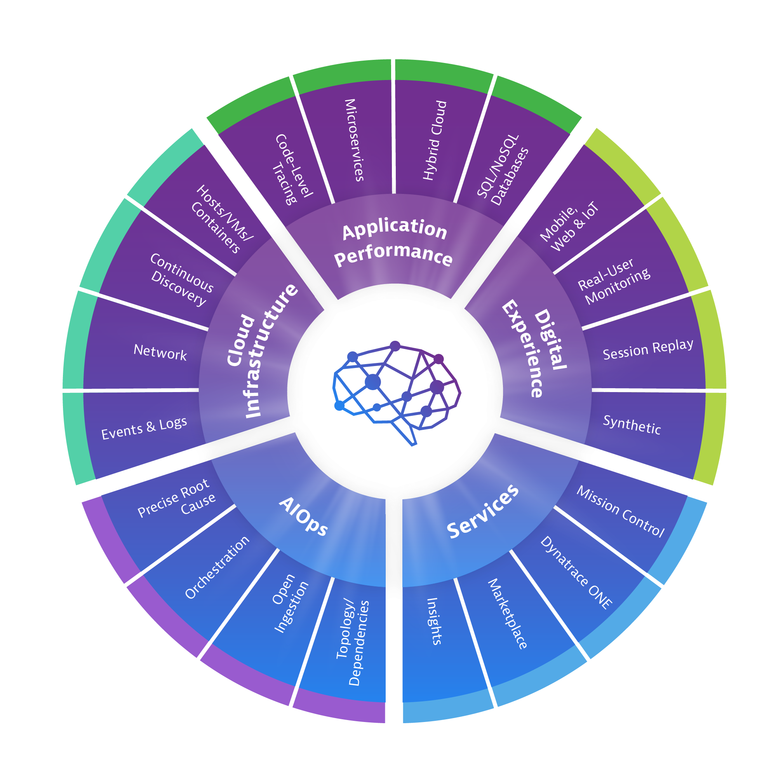
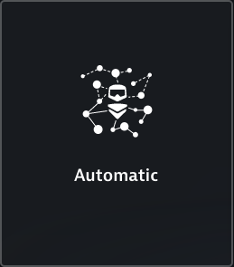
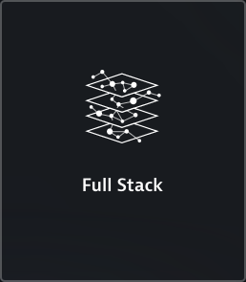
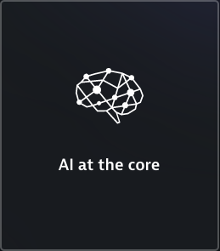
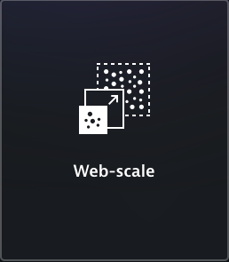
The Software Intelligence Platform
What is Dynatrace?
All-in-one, all you need
Why we are radically different
Notes:
Automatic - Zero-touch configuration, continuous discovery and relationship mapping in real-time, instant answers and precise causation.
Full Stack - Understand all the relationships and interdependencies, top to bottom, from end-user experience to infrastructure health.
AI at the core - Radically different open AI-engine, Davis, processes billions of dependencies for instantly precise answers beyond human capabilities.
Web-scale - Scale-out cloud native architecture, role-based governance for large global teams, and automatic enterprise-wide deployment.

Slide 6
Dynatrace Business Value Framework
Operational Resilience
Staff Productivity
Cost Savings
Business Agility
https://www.uline.com/Grp_437/DolliesW
Typical Focus
Most compelling benefits
Benefits from reducing outages, improving SLAs and improving time to resolution
Software and hardware savings / avoidance from multiple monitoring tools by moving to a all-in-one platform
Faster and more frequent deployments of new features with fewer errors
What is it?
Improvements in efficiency
Deployed Dynatrace across 12,000 prod hosts while BBQing at home. (SAP)
Consolidated 15 tools with Dynatrace (Beachbody)
3x faster release cycles 50% faster deployments (Verizon)
Examples
80% reduction in outages (Westpac)

Slide 7
Examples of realized value
Operational Resilience
Staff Productivity
Cost Savings
Business Agility
80% reduction in outages (Westpac) | Fewer performance incidents and faster resolution improves productivity by 40%. | Redundant/multiple tools replaced by single all-in-one platform (TraceOne) | Development provides services to the market 45% faster.
50% reduction in issues (Verizon) | What we didn’t expect was the degree to which Dynatrace energized our team. (Air Canada) | It was faster & cheaper to implement Dynatrace vs. building a solution ourselves. (SAP) | One complete source of truth vs a “suite” of disparate data sets.
Reduction in MTTI, between 60% and 85% over older-generation APMs (Forrester study) | 95% less time spent installing and upgrading. (Global heating & cooling manufacturer) | Dynatrace requires less hardware than alternative solutions. | Improvement of satisfaction of internal and external users.
Time savings in war room triage of 10+ hours per incident (Forrester study) | We estimate that a typical enterprise would gain over $4.4 million in productivity. | Organizations accelerated to modern clouds with confidence using Dynatrace, bringing a time-to-value savings on infrastructure operational costs. (Forrester study) | New projects yield results four months sooner with Dynatrace (Forrester study)
IT operations identify issues 75% faster on Dynatrace than legacy APM. (Forrester study) |  |  | Bounce/abandonment rates improved by 17% (Forrester study)

Slide 8
Typical Use Cases and Proof Points
Operational Resilience
Staff Productivity
o ROI Opportunity: Reduce mean time to resolution of issues and reduce number of required resources
o Proof points:
Problem tickets
Root-cause
Determination of end-user or service impact
Reduce alert storms by finding only faulty tiers
Availability of system during peak and low traffic times
o ROI Opportunity: Increase market share by increasing feature set and focusing on innovation rather than troubleshooting
o Proof points:
Monitor current and future technologies
Application/Environment changes tracked automatically
Can be leveraged in both non-prod and prod
Cost Savings
Business Agility
o ROI Opportunity: Reduce costs associated with disparate tools, training, and maintenance
o Proof points:
Quick installation (fully automated)
True full-stack monitoring
Monitor all technologies discretely
Integration with other enterprise technologies / platforms
Fully automatic updates / upgrades
o ROI Opportunity: Increase conversion rate by understanding true user performance and behavioral workflows
o Proof points:
User experience and backend performance correlation
How performance affects conversion rate
Discrete user session tracking
Reports to showcase changes

Slide 9
Additional <customer> specific use cases and success criteria
Use Case #1
Use Case #2
Validation #1
Validation #2
Validation #3
Validation #4
Validation #1
Validation #2
Validation #3
Validation #4
Use Case #3
Use Case #4
Validation #1
Validation #2
Validation #3
Validation #4
Validation #1
Validation #2
Validation #3
Validation #4

Slide 10
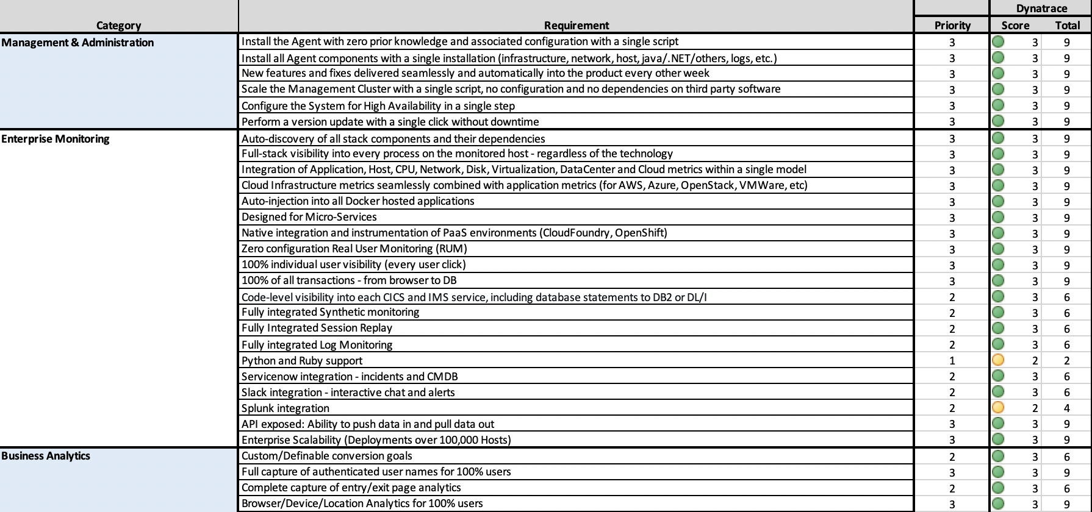
Comparing Full-stack Monitoring Solutions
In order to effectively evaluate the Dynatrace platform against other solutions, we recommend building a scorecard which spans all use cases, present and future, and assigns a priority to each.
Your Account Team will provide a sample scorecard from
Notes:
Include for competitive POCs

Slide 11
Dynatrace Adoption Goals
Immediate | End War Rooms End blind spots Gain visibility into User Experience Handle cloud / microservices complexity Goal: ____ hours
Mid-term | Gain visibility into User Segmentation & Behavior Provide business KPIs & insights Integrate into ticketing, CMDB, & ChatOps Goal: ____ days
Longer-term | Self-Service Monitoring (OneAgent, metadata, tagging, MZs, alerting, etc all automated) Deploy Keptn On-demand Quality Validation Fully Automated Delivery Pipeline Self-Healing for common root causes Goal: ____ weeks
Self Healing
Fully automated delivery pipeline
On-demand Quality validation
Self-service monitoring
Notes:
Align Customer’s longer term adoption goals. This helps provide the vision for after the POC.
Immediate – These are achievable out-of-the-box
Mid-term – These require a small amount of application knowledge but can be configured from the Dynatrace UI
Longer-term – Timing here depends on Customer’s existing maturity level with modern tooling, CI/CD, and DevOps practices.

Slide 12
Some Things to Remember
Dynatrace OneAgent installation REQUIRES elevated permissions or administrator to install
Dynatrace Managed Server installation REQUIRES elevated permissions or administrator to install
Dynatrace shows best in an environment with Production-like load
Dynatrace REQUIRES a public internet connection for both the on-premise (Managed) and SaaS deployments
Dynatrace OneAgent CANNOT be run in parallel with other APM agents
Applications MAY require a restart after initial installation of Dynatrace OneAgent on each host

Slide 13
<Customer> Application and Infrastructure diagrams
Notes:
Include if customer has detailed diagrams. This provides a good comparison after auto-discovery, e.g. to show what they were missing, where there were blind spots.

Slide 14
Estimated POC Sizing
Environment | Application | Purpose | Full-stack | how many | GB RAM | Platform / OS | App vendor / technology
Non-Prod | App 1 | App servers | Yes | 20 | 16 | OpenShift | Java
 |  | DB | No | 1 | 512 | RHEL7 | Oracle
Prod | App 1 | App servers | Yes | 100 | 16 | OpenShift | Java
 |  | DB | No | 5 | 512 | RHEL7 | Oracle
name of environment | name of application | Web Server |  |  |  | virtual / physical host | vendor and version
 |  | App Server |  |  |  | PaaS or FaaS | framework
 |  | Database Server |  |  |  | public or private cloud | programming language
 |  | Mainframe |  |  |  | Microservices
 |  | IIB/MQ |  |  |  | Containers
REAL USER MONITORING | number of visits per month | Session Replay (Y/N) | Volume of complete user sessions to the app(s) being monitored per month estimate
 | 1m | Y
Synthetic MONITORING | Browser / HTTP Check | Public / Private | Number of tests | Actions / test | Locations | Frequency
 | Browser | Public | 5 | 10 | 3 | 15 min
 | HTTP Check | Private | 20 | 1 | 2 | 5 min
Notes:
Example values shown. Fill in collaboratively with customer. Goals are three fold:
Have a defined scope for the POC
Size POC license appropriately (e.g. > 400 HU in SaaS may be provisioned on dedicated cluster)
Prepare for a pricing exercise later in the POC

Slide 15
Internal - POC sample timeline
4.5 days
SE
4.5 days
3.5 days
POC Phase 0 (Prep)
POC Phase 1 (Staging)
POC Phase 2 (Prod)
Jan 7 - Jan 11
Jan 14 - Jan 18
Jan 21 - Jan 24
8.3 days
Prove the solution meets reqs
Jan 14 - Jan 24
Email day 1
Technical prep call
Deliver technical wrap up
Jan 9
Install Dynatrace
POC start
Email day 2
Jan 16
Mid-point demo
Email #6
Build technical wrap up
Jan 25
POC end
Jan 11
Jan 14
Jan 15
Jan 18
Jan 21
Jan 25
Jan 23
2019
Sales rep
2019
Mon
Wed
Fri
Sun
Tue
Thu
Sat
Mon
Wed
Fri
Today
Engage with services
Jan 11
Security review/approval for prod
(if needed)
Jan 15
Identify BIP Audience
Build BIP
Internal BIP review
Jan 23
Deliver BIP
Get mutually agreed success criteria
Begin building the ROI
Jan 9
Jan 22
POC Planning Guide:
Shape reqs
Shape timeline
Shape ROI
Jan 7
Develop the business justification
8.3 days
Jan 10 - Jan 22

Slide 16
Internal - POC Steps
SE tasks
Lead technical prep call.
Guide the Dynatrace install.
Let the customer do the install themselves. The SE should only provide the guidance.
Prove the solution vs. the requirements.
Send POC progress emails (day 1, day 2, week 2).
Blast out the emails so they go viral across the organization (rep provides addresses).
Mid-point live demo
Build technical wrap up presentation (this is not a BIP).
Sales rep tasks
Shape the requirements, building ROI and controlling the timeline from the start.
Set expectations.
AppD will promote being hands-on and on-site for weeks as a positive thing.
Our expectation is that YOU (the customer) will want to experience the solution yourself.
Gather and document the mutually agreed POC success criteria.
Make sure services is engaged and aware of the customer objectives.
Get security review/approval scheduled (if needed for prod install)
Build the business justification
Build the BIP.
Have an internal BIP review session with RD, SE, SE manager, Ryan, etc. to collaborate on making any improvements to the BIP.

Slide 17
POC sample timeline
4.5 days
4.5 days
3.5 days
POC Phase 0 (Prep)
POC Phase 1 (Staging)
POC Phase 2 (Prod)
Jan 7 - Jan 11
Jan 14 - Jan 18
Jan 21 - Jan 24
Install Dynatrace in Staging
POC Start
Install into Prod
POC End
Jan 11
Jan 14
Jan 19
Jan 25
2019
Mon
Wed
Fri
Sun
Tue
Thu
Sat
Mon
Wed
Fri
2019
Today
Jan 9
Mutually Agreed POC success criteria
Mid-point Live Demo
Jan 18
Deliver Business Impact Presentation
and POC Wrap Up
Technical Prep Call
Jan 9
Jan 15
Security review/approval for prod
(if needed)
Jan 7
Review Sample POC Guide
8.3 days
Prove the solution meets reqs
Jan 14 - Jan 24
Notes:
A well planned POC should not take longer than 2 weeks. Be sure to identify and plan for potential blockers, e.g. change management approvals, infosec reviews, additional stakeholders, etc. Modify based on Mutually Agreed Plan (MAP).

Slide 18
SaaS or Managed?
Dynatrace SaaS | Dynatrace Managed
Easy SaaS experience providing AI-powered Answers & Insights | Same SaaS-like experience in an on-premise model AI-powered Answers & Insights
Sign-up with email, start monitoring in 5 minutes | Receive Welcome Email, copy-paste install, start monitoring in 30 minutes
Dynatrace provides software, compute, storage | Dynatrace provides software, you provide compute & storage
Automatic updates every 2 weeks | Automatic updates every month
Your data is safe & secure in Dynatrace’s AWS tenant | Your data is safe & secure in your own datacenter, private, or public cloud

Slide 19
Dynatrace SaaS architecture
FIREWALL
443
Dynatrace SaaS cluster
ActiveGate
( recommended )
9999
9999
443
443
host
host
host
Web UI
When is an Environment ActiveGate needed?
Consolidation & Compression of OneAgent traffic
Enterprise Cloud platform integrations (vCenter, K8s, PCF, AWS, Azure, etc)
Extensions, plugins, and DB Insights
Private synthetic locations
Storage of memory dumps
More Detail
PaaS /
container
PaaS /
container
PaaS /
container
OneAgents

Slide 20
Dynatrace SaaS requirements
Firewall Configuration
Requirements
The following ports are required open Outbound in your firewall(s):
port 443 for TCP/HTTPS/SSL connection from OneAgent to Dynatrace SaaS Cluster Servers hosted in Amazon AWS
Dynatrace SaaS Cluster Server IP addresses for whitelisting (see Deploy Dynatrace screen for your cluster IPs)
DNS resolution for *.live.dynatrace.com needed during installation of OneAgent
With ActiveGate (recommended): port 443 for TCP connections from Dynatrace ActiveGate to SaaS Cluster Servers (SSL)
Port 9999 for HTTPS connections from OneAgent to Dynatrace ActiveGate (within internal network only)
Dynatrace ActiveGate
Server Requirements
64bit Virtual or Physical (non container) host with: 2 vCPU / 4GB RAM / 2GB Disk
Administrative privileges for install
Windows 7+, Windows Server 2008+, RHEL 6+, Ubuntu 12.04+, openSUSE 13, CentOS 6+, Amazon Linux 2014.03+ Additional requirements for Private Synthetics: Details
Dynatrace OneAgent
Installation Requirements
Administrative privileges required to install OneAgent in host operating system
Windows: Windows Server 2008-2019, Nano and Windows 7SP1, 8.1, 10 (see details)
Linux: RHEL 5.4 (without SELinux), 6.1+, CentOS 6+, Ubuntu 12.04+, SUSE 12+, Debian 7+, Fedora 26+, CoreOS 835.13+ (with permissive SELinux) Various Others
IBM AIX: 6.1 TL9 SP9, 7.1 TL3 SP9+, 7.1 TL4 SP4+, 7.1 TL5+, 7.2 TL0 SP4+, 7.2 TL1 SP2+, 7.2 TL2+
SOLARIS: for Java and Apache Server 10 1/13+ (SPARC, x86)
Disk Space: minimum 7GB of free local space (default /opt in Linux)
Memory: minimum 1GB RAM

Slide 21
Dynatrace Managed (on-premise) architecture
FIREWALL
443
443
Dynatrace Mission Control
Dynatrace Managed Node
environment
or cluster
ActiveGate
(recommended)
9999
9999
443
443
Dynatrace Managed Node:
Aggregates, analyzes, and stores all monitoring data
Periodically connects to Dynatrace Mission Control for health checks, licensing, and updates
Serves the Dynatrace Cluster Management Center and UI
Scales horizontally
When to use an Environment ActiveGate?
Consolidation & Compression of OneAgent traffic
Enterprise Cloud platform integrations (vCenter, K8s, PCF, AWS, Azure, etc)
Extensions, plugins, and DB Insights
Private synthetic locations
Storage of memory dumps
More Detail
When to use a Cluster ActiveGate?
Anything related to external data: Synthetic tests, mobile app monitoring, Davis integration, Dynatrace notification mobile app, agentless RUM
Access to a sealed network
More Detail
host
host
host
client
PaaS /
container
PaaS /
container
PaaS /
container
OneAgents

Slide 22
Dynatrace Managed requirements
Firewall Configuration
Enable (outbound): 443 (TCP/HTTPS) from on-premise Dynatrace Cluster Server(s) to Dynatrace Mission Control (in Amazon AWS). If you have a proxy, make sure to enable: websockets, sticky sessions, support for TLS v1.2 and SNI TLS extension
Whitelist open access to these IPs: 52.5.224.56, 52.200.165.10, 52.221.165.63, and 13.228.109.33 (Mission Control in AWS)
DNS resolution to: mcsvc.dynatrace.com required
Without Dynatrace ActiveGate:
Port 443 (TCP/HTTPS) from OneAgent to Dynatrace Cluster Server(s)
With Dynatrace ActiveGate(s):
Port 9999 (TCP/HTTPS) from OneAgent to ActiveGate(s)
Port 443 (TCP/HTTPS) from ActiveGate to Dynatrace Cluster Server(s)
For POCs with Synthetic Monitoring or Mobile Apps, it will be necessary for the Dynatrace ActiveGate to have a published IP/Port on the Internet
Dynatrace Cluster Server requirements
Dedicated 64-bit server, virtual or physical (no container)
Hardware (for POC):
4 vCPU
32 GB RAM
200 GB disk
(/opt with 6GB)
LVM recommended
Administrative privileges for install
Linux OS: RHEL 6+, CentOS 6+, Ubuntu 12.04+, SUSE 12.x+, others
Config mgmt disabled / whitelisted (e.g. Chef/Puppet/Ansible) details
Dynatrace ActiveGate requirements
64bit Virtual or Physical (non container) host with: 2 vCPU / 4GB RAM / 2GB Disk
Administrative privileges for install
Windows 7+, Windows Server 2008+, RHEL 6+, Ubuntu 12.04+, openSUSE 13, CentOS 6+, Amazon Linux 2014.03+ Additional requirements for Private Synthetics: Details
Dynatrace OneAgent requirements
Administrative privileges required to install OneAgent in host operating system
Windows: Windows Server 2008-2019, Nano and Windows 7SP1, 8.1, 10 (see details)
Linux: RHEL 5.4 (without SELinux), 6.1+, CentOS 6+, Ubuntu 12.04+, SUSE 12+, Debian 7+, Fedora 26+, CoreOS 835.13+ (with permissive SELinux) Various Others
IBM AIX: 6.1 TL9 SP9, 7.1 TL3 SP9+, 7.1 TL4 SP4+, 7.1 TL5+, 7.2 TL0 SP4+, 7.2 TL1 SP2+, 7.2 TL2+
SOLARIS: for Java and Apache Server 10 1/13+ (SPARC, x86)
Disk Space: minimum 7GB of free local space (default /opt in Linux)
Memory: minimum 1GB RAM

